Slide 1
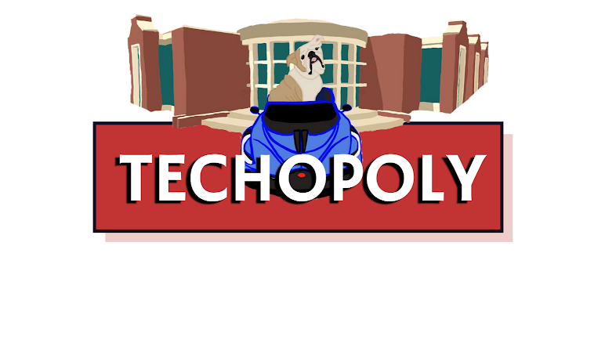
Created By: The Techopolist

Slide 2
What is It?
Techopoly is a mobile, Louisiana Tech themed monopoly game
Eliminates the need for pieces and paper money by keeping track of each player, their properties, and money values
Main goal was to make a mobile monopoly game
Enclosing the game in a suitcase allowed for the hardware and software to be integrated cleanly and unseen

Slide 3
How Does It Work?
On the hardware side, we used a Raspberry Pi, breadboard, and three tactile switches for visual and engaging gameplay
The software was implemented to keep track of each player electronically
We’ve used different images to replace game pieces
We also established player classes with monetary values, locations, and owned properties

Slide 4
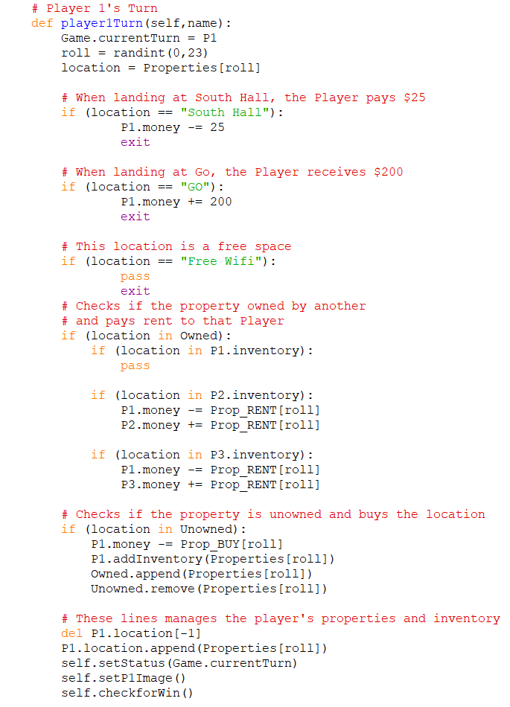
Integration of Software
To the right is a sample of our player turn
We utilized classes, functions, and various if statements to keep track of each player and their values

Slide 5
Demonstration

Slide 6
Hurdles and Possible Changes
Keeping track of player turns and properties
GUI integration
Switch implementation

Slide 7
Future Development
Future plans would be to have a feature that asked if you wanted to buy a property
Having a function that keeps the order of the player’s turns
On the hardware side, possibly using a smaller suitcase for better portability

